Slide 1
Air Traffic Delay Prediction
Team 9
Harshada Kailas Bagal, Sahithi Muppavaram
INFO6105 - Data Science Engineering Methods and Tools

Slide 2

Introduction
Modern transportation relies heavily on-air travel to link people and commerce worldwide. On the other hand, flight cancellations and delays can cause major problems for travelers and airlines, interfering with schedules and creating delays. With recent advancements, Machine learning techniques are capable of analyzing past flight data to find trends and patterns linked to delays.
The primary objective of this project is to provide travelers with well-informed choices and to provide airlines with important information to improve customer happiness and operational efficiency.
Our project's main goal is to identify patterns and trends related to aircraft delays and cancellations in the United States by analyzing a large dataset on these events. Our objective is to offer significant insights that enable people to make more informed decisions about their travel plans by exploring the fundamental causes of airline delays.

Slide 3
Description of Dataset
The dataset comprises three distinct files containing data of flights, airlines, and airports, each providing valuable information in the context of air traffic delay predictions:
1. Flight Dataset
The flight data gives certain operational details about every flight. The dataset size is 567MB with 57,00,000+ records.
2. Airport Dataset
Airport data is primarily used to identify an airport using its IATA Code.
3. Airlines Dataset
The airline’s data set enables the study of flight data by carrier by giving each airline a unique identity (IATA_CODE) and name.

Slide 4

Dataset Files Details
Flights.csv
Flight number
Year
Month
Day
Day of week
Airline
Flight name
Tail number
Origin airport
Destination airport
Scheduled Departure
Departure Time
Departure Delay
Taxi_out:
Wheels_on
Wheels_off:
Air_Time

Slide 5

Airport.csv
IATA Code
Airport
City
State
Country
Latitude
Longitude

Slide 6

Airlines.csv
IATA_CODE
Airline

Slide 7
Data Cleaning & Preprocessing
a. Finding Missing Values
1
b. Filling Missing Values
2
c. Dropping Rows with Missing Values
3
d. Eliminating Unnecessary Columns
4

Slide 8
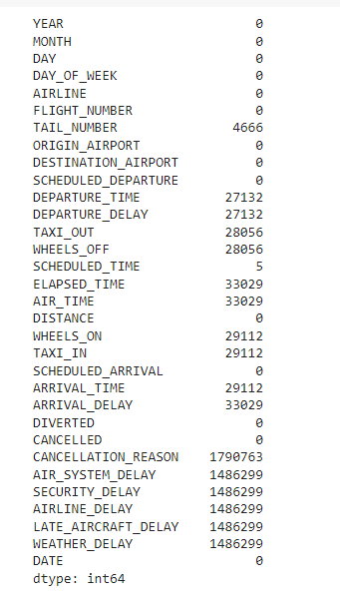

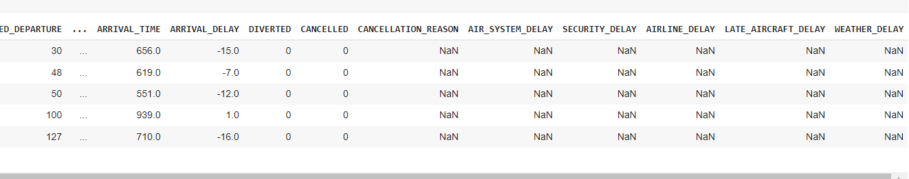
Finding Missing Values

Slide 9
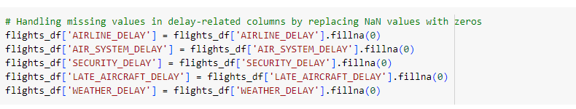
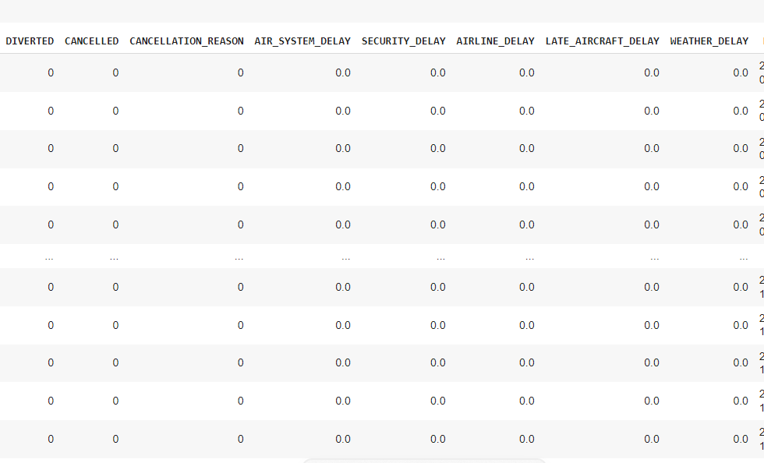
Filling Missing Values

Slide 10

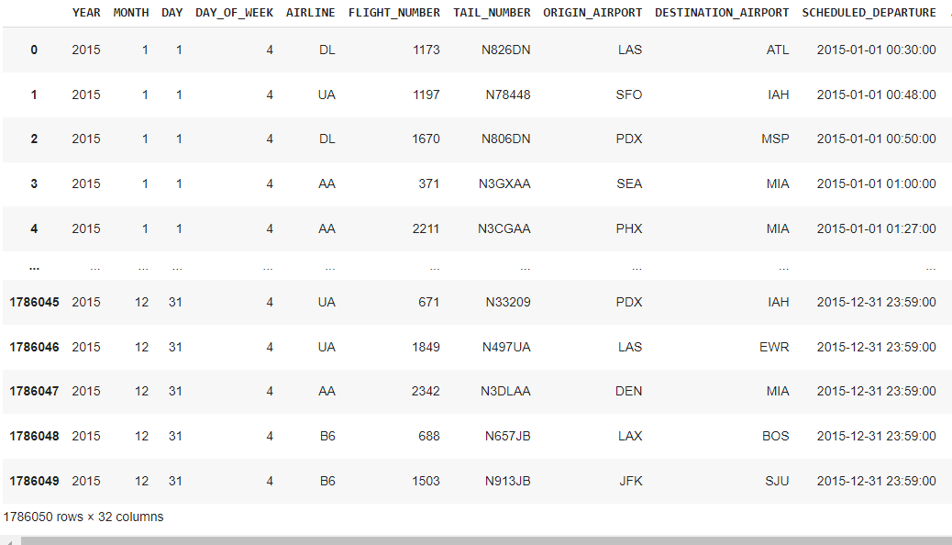
Dropping Missing Values

Slide 11
Eliminate Unnecessary Values

Slide 12
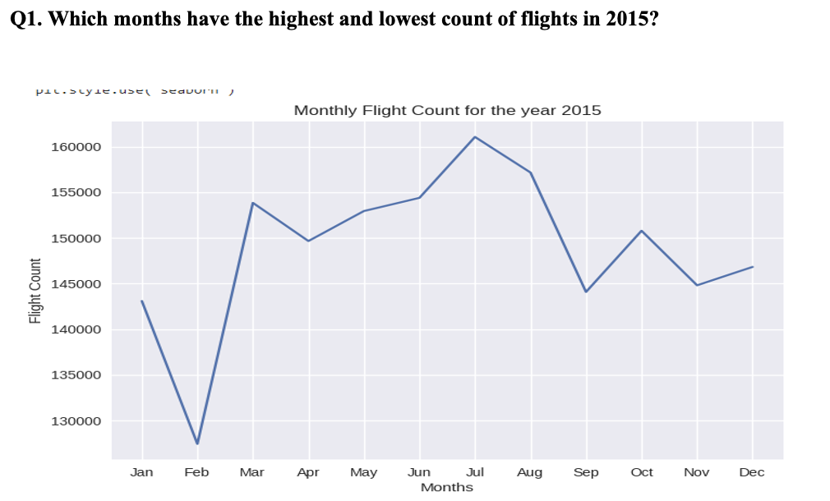
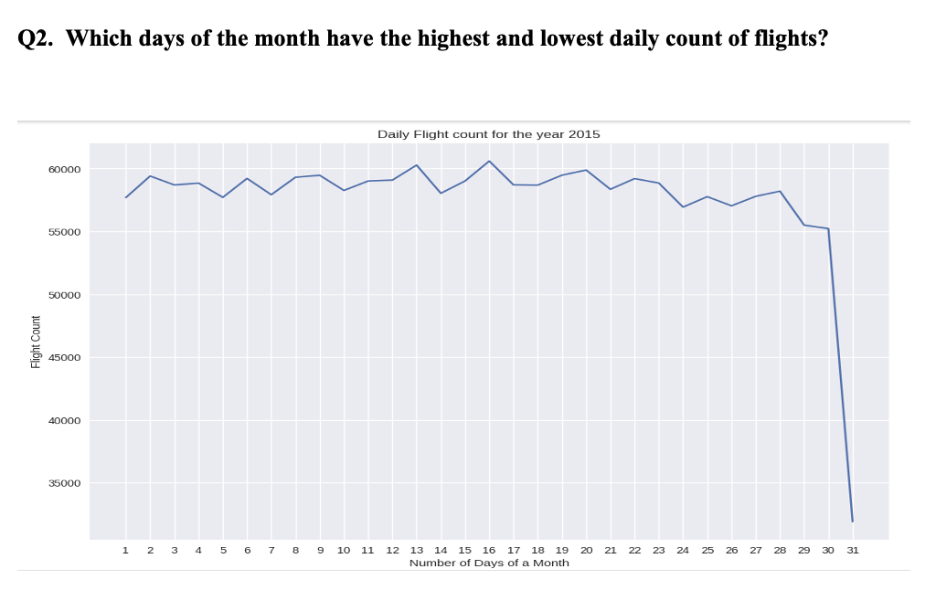
Exploratory Data Analysis
We started the EDA process by obtaining the current month from the dataset's date column. This is done because one important time-based factor that affects flight delays is the month. Dataset has a 'DATE' column, from which the 'MONTH' is extracted and added to a new column. This stage is crucial for examining the variations in flight delays between months, which may be brought on by seasonal travel trends or meteorological circumstances.

Slide 13
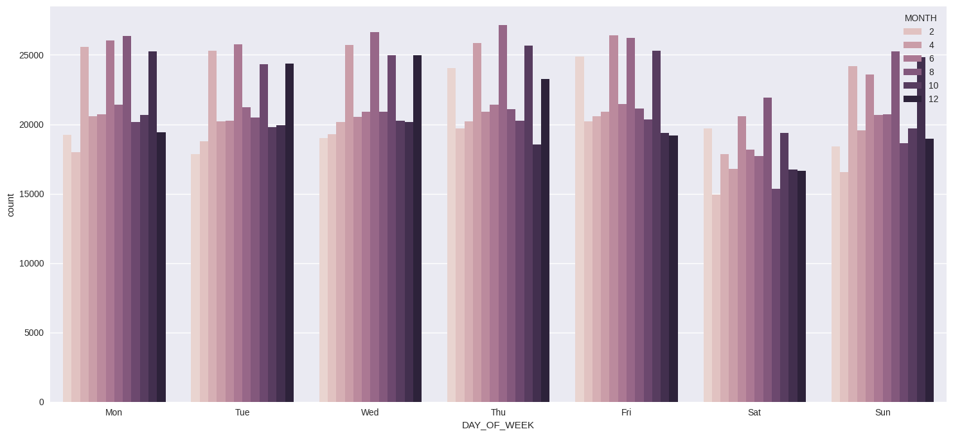
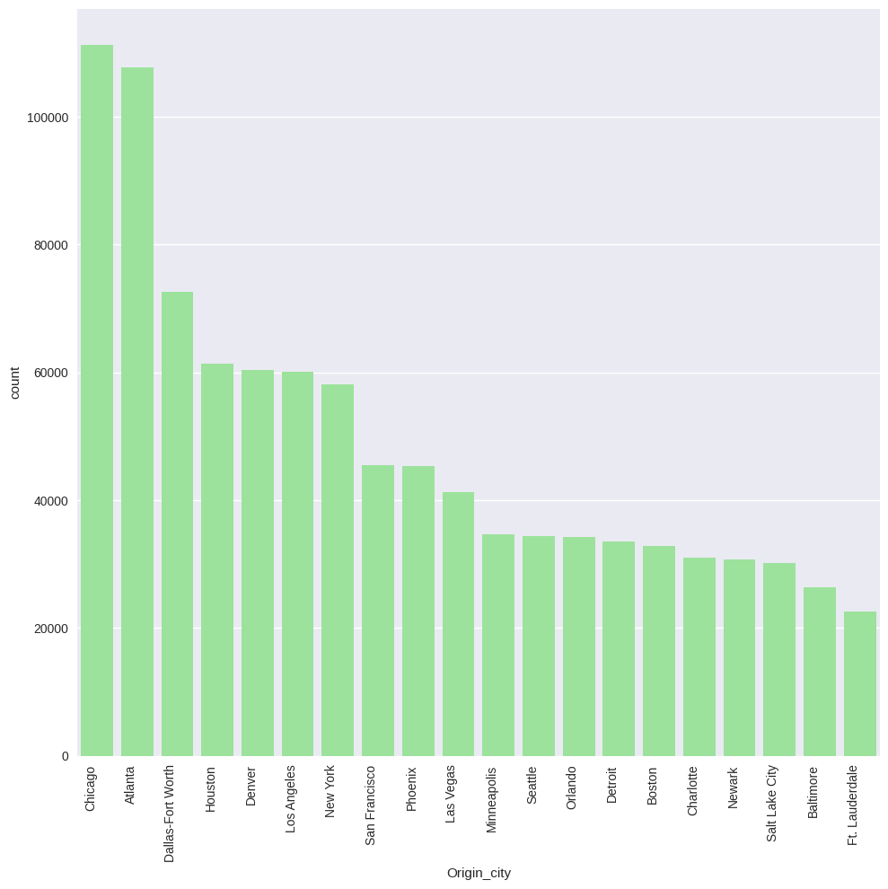
Exploratory Data Analysis
Q3. What do the weekly and monthly variations in daily flight counts suggest about travel trends?
Q4. Which origin city had the highest count of flights in 2015?
- Here we are analyzing data monthly based on weekdays for each month. All in all , we can see that there is no big difference between the showcased data
- Here we can see that Chicago has the highest number of flights in the year if 2015. Atlanta being the second highest Origin city

Slide 14
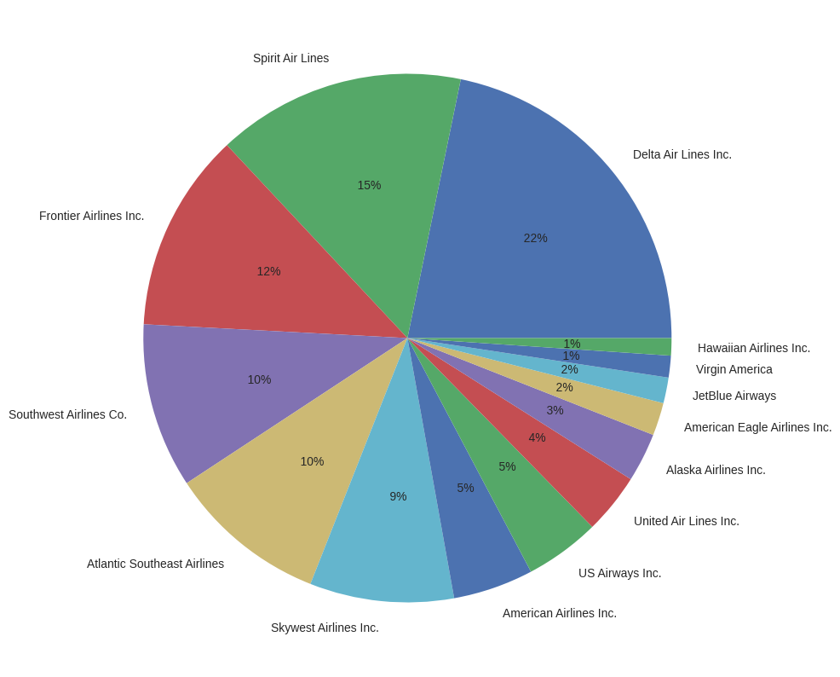
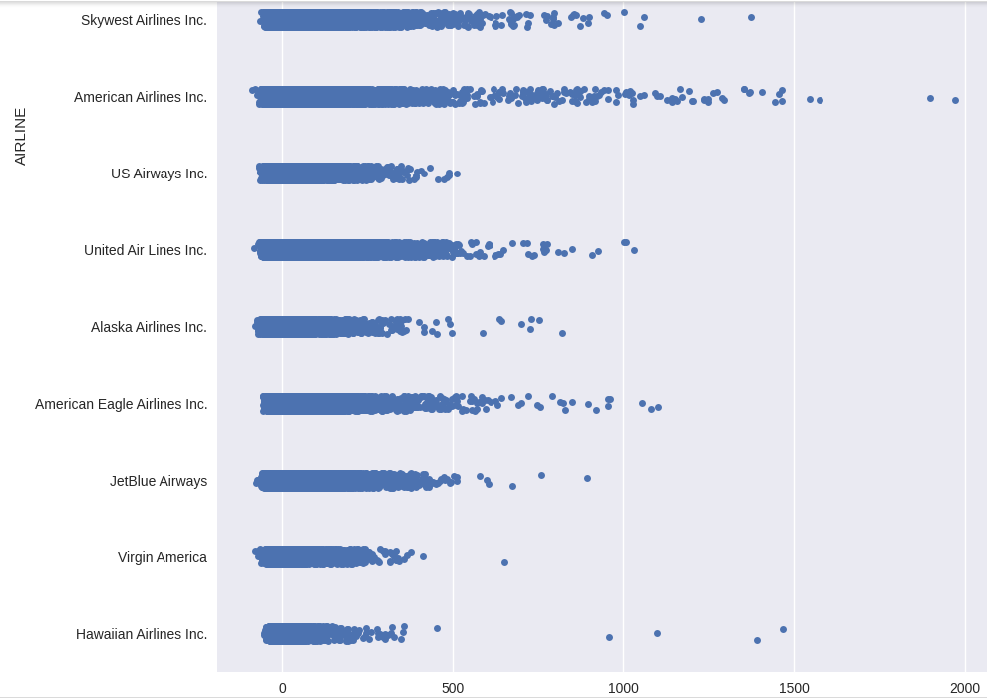
Exploratory Data Analysis
Q5. What is the count of flights for each airline?
Q6. Which airline has the highest arrival delay in 2015?
- Delta airlines had the highest amount of flights in 2015 with about 15% and Spirit airlines being the second highest
- American Airline has the highest arrival delay.

Slide 15
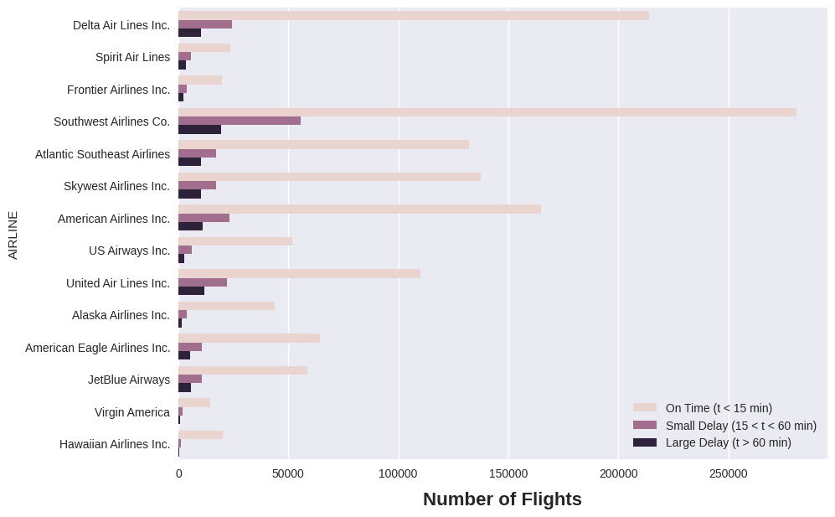
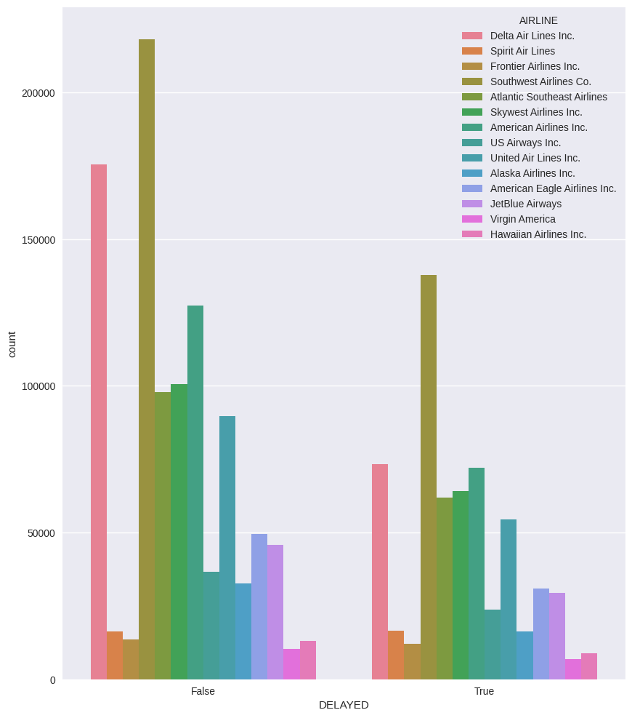
Exploratory Data Analysis
Q7. Which airline have delayed and not delayed according to the counts of airline?
Q8. Which airline have delayed and not delayed according to the counts of airline?
- Atlantic Southeast Airlines and American Airlines are the most delayed flights

Slide 16

Feature Engineering
In feature engineering, we try to create multiple features which can help us understand the data in a much simpler and more accurate way.
The steps for Feature Creation are as follows:
Creating Date column as there is year, month, and day
Merged all the datasets i.e flights, airlines, and airports
Mapping cancellation reasons to numerical values dataset
Converting ‘Wheels_On’ and ‘Wheels_Off’ values to minutes
Converting ‘Scheduled_Departure’ column values to standard date time format
Converting ‘Departure_Time’ column values to standard date time format
Converting ‘Scheduled_Arrival’ column values to standard date time format
Converting ‘Arrival_Time’ column values to standard date time format

Slide 17
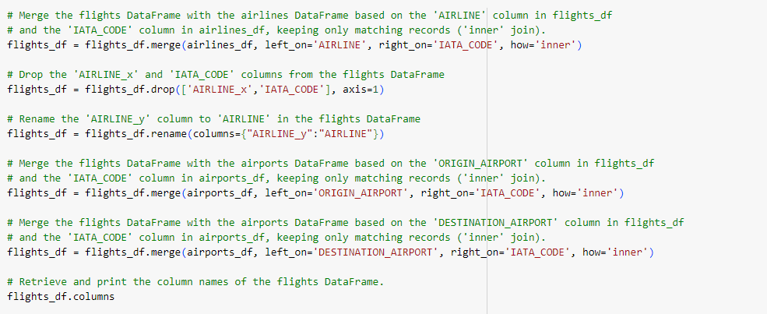
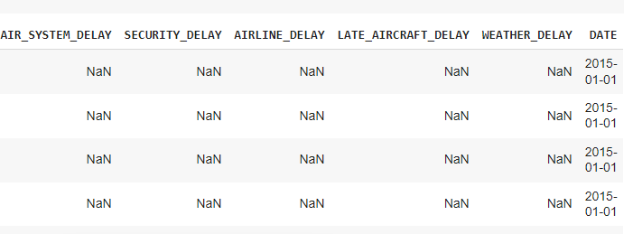
Feature Engineering
Creating Date column as there is year, month, and day &
2. Merged all the datasets i.e flights, airlines, and airports

Slide 18
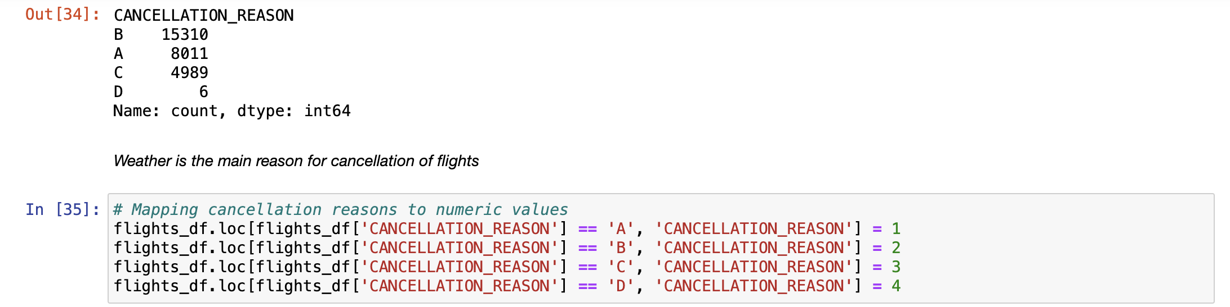
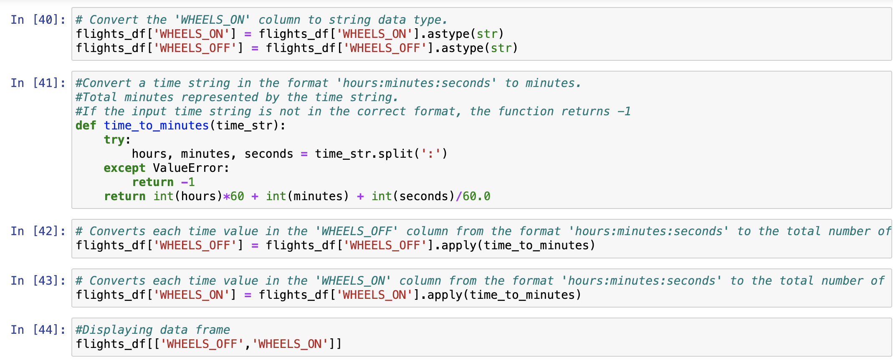
Feature Engineering
3. Mapping cancellation reasons to numerical values dataset
4. Converting ‘Wheels_On’ and ‘Wheels_Off’ values to minutes

Slide 19
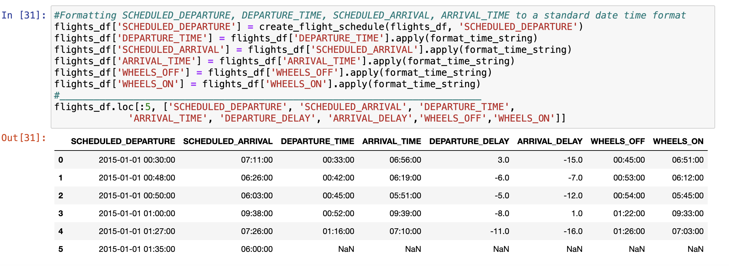
Feature Engineering
5. Converting ‘Scheduled_Departure’, ‘Departure_Time, ‘Scheduled_Arrival’, ‘Arrival_Time’ column values to standard date time format

Slide 20
Modelling strategies
Linear regression
Random Forest Regression
XGBoost Model
KNN Regression

Slide 21
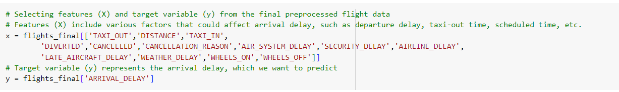
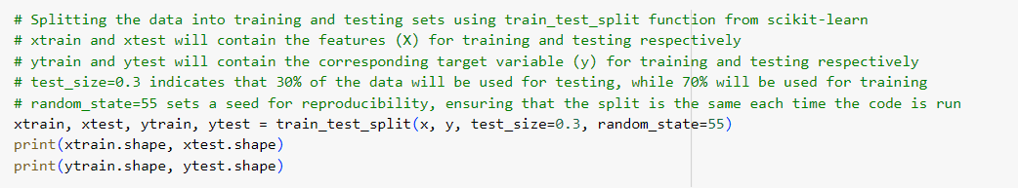
Splitting Dataset for Modelling

Slide 22
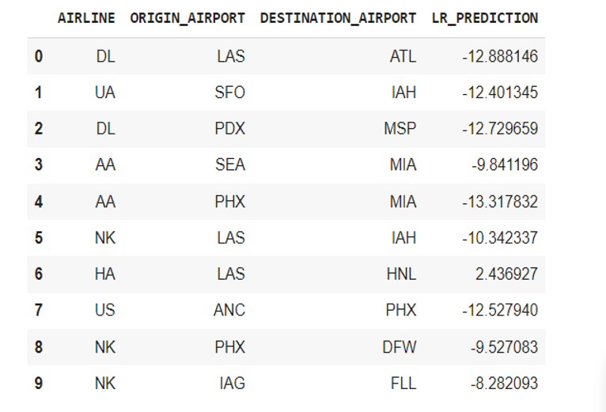
Linear Regression
R^2 | MAE | MSE | RMSE
0.94 | 7.51 | 91.8 | 9.58

Slide 23
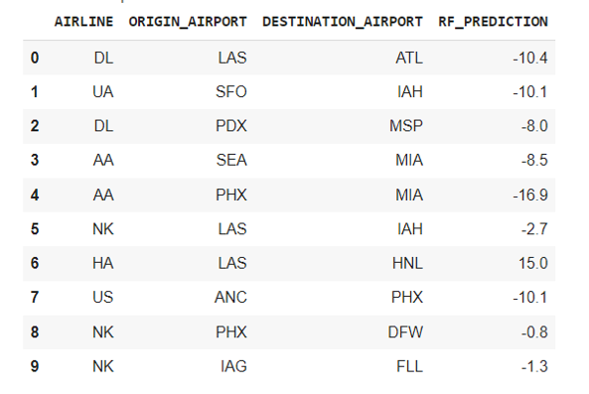
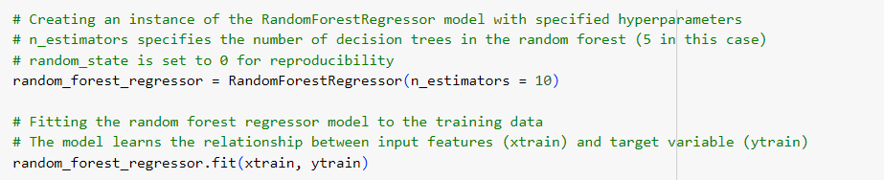
Random Forest Regression
R^2 | MAE | MSE | RMSE
0.95 | 5.93 | 74.94 | 8.65

Slide 24
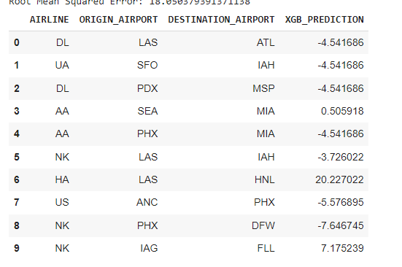
XGBoost Model
R^2 | MAE | MSE | RMSE
0.79 | 10.58 | 325.81 | 18.05

Slide 25
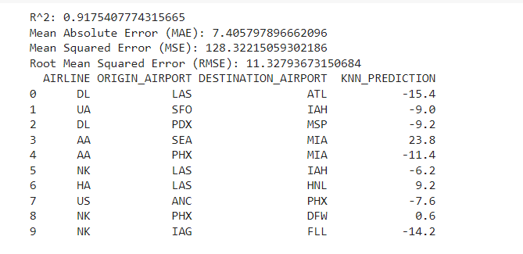
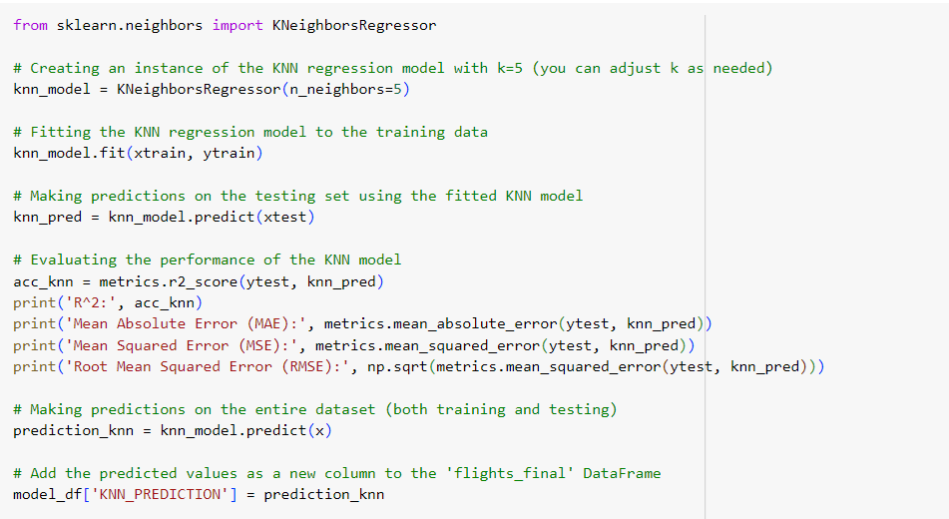
KNN Regression
R^2 | MAE | MSE | RMSE
0.91 | 7.40 | 128.32 | 11.32

Slide 26
Hyperparameter Tuning
The process of fine-tuning a model's hyperparameters is essential to maximizing its performance.
GridSearch CV for Comprehensive Lookup: In order to ascertain which tune provides the optimum performance, this method methodically cycles through several combinations of parameter tunes, cross-validating along the way.
Here we have employed Hyperparameter Tuning on Random Forest Regression and Decision Tree Classifier.

Slide 27
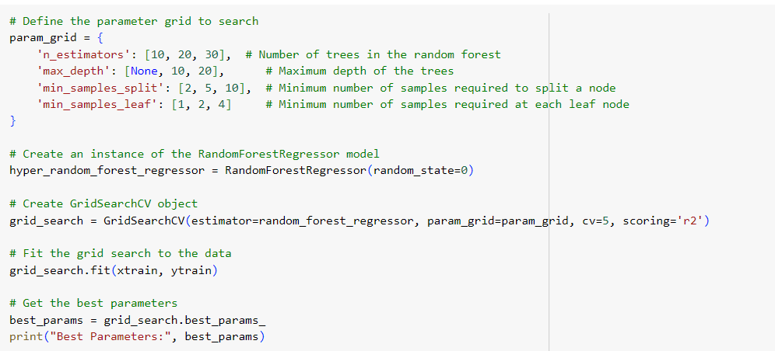
Random Forest Tuning
R^2 | MAE | MSE | RMSE
0.92 | 6.61 | 111.31 | 10.55
We focused on the number of trees, maximum depth, and minimum samples per leaf and split while using GridSearch CV to search over a specified parameter grid to discover the optimal combination of parameters for the Random Forest model.

Slide 28
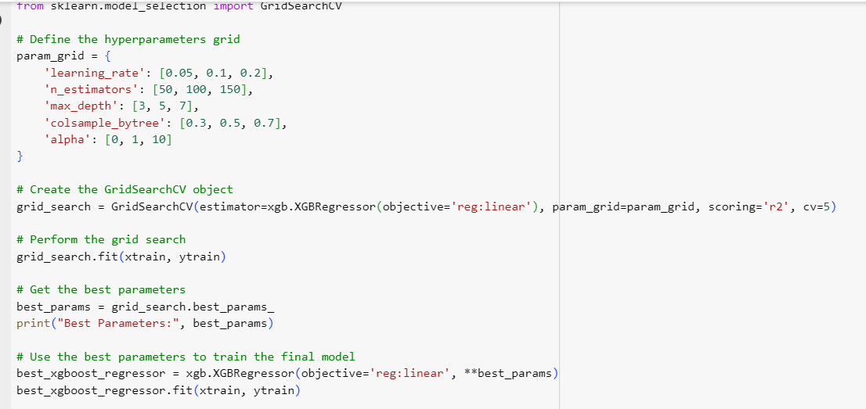
XGBoost Model Tuning
R^2 | MAE | MSE | RMSE
0.93 | 6.90 | 112.92 | 10.62

Slide 29
Result and Analysis
We engaged in feature engineering to extract crucial insights from the provided dataset. Subsequently, we utilized this enriched dataset to train our machine learning models, incorporating hyperparameter tuning to enhance predictive performance.
Following a thorough examination of these models, we determined 'Random Forest Regression' as the most effective model for our use case, as evidenced by its accuracy score of 0.95 and the lowest RMSE among all models.
ML Model | R2 | RMSE
Linear Regression | 0.94 | 9.58
Random Forest Regression | 0.95 | 8.65
KNN Regression | 0.91 | 11.32
XGBoost Model | 0.79 | 18.05
Random Forest Hyperparameter Tuning | 0.92 | 10.55
XGBoost Hyperparameter Tuning | 0.93 | 10.62

Slide 30
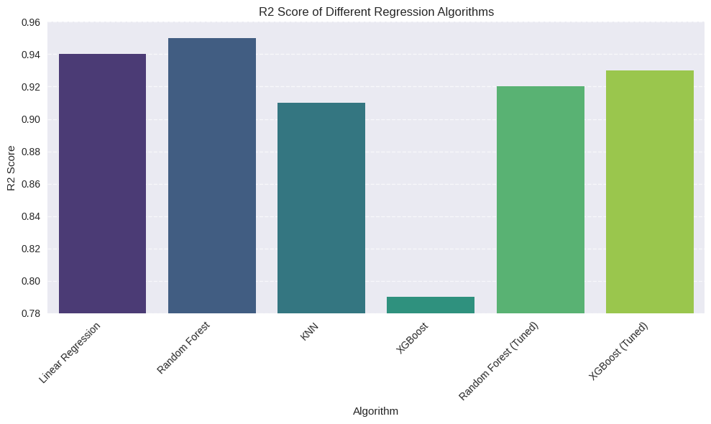
Result and Analysis

Slide 31
Conclusion
Our goal in this project was to forecast flight delays.
We applied a range of machine learning models, each optimized to maximize its performance, such as KNN Regression, XG Boost, Random Forest Regression, and Linear Regression, utilizing a rich dataset.
We concluded that the standard Random Forest Regression model was the best model for our project on predicting air traffic delays.
Through this project, we are able to identify patterns and trends related to aircraft delays and cancellations in the United States by analyzing a large dataset on these events.

Slide 32
THANK YOU

